Slide 1
Securing your .NET application software supply-chain the practical approach! (workshop)
NDC { London }
Niels Tanis

Slide 2

Who am I?
Niels Tanis
Sr. Principal Security Researcher @ Veracode
Background .NET Development, Pentesting/ethical hacking, and software security consultancy
Research on static analysis for .NET apps

Slide 3
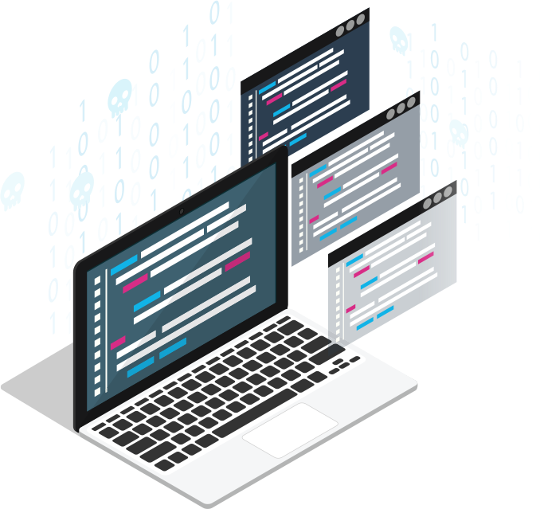
Securing your .NET application software supply-chain
Notes:
Picture is from Veracode report/site:
https://www.veracode.com/sites/default/files/pdf/resources/ipapers/everything-you-need-to-know-open-source-risk/index.html

Slide 4
Agenda
Definition Software Supply-Chain
Securing the Software Supply-Chain
Developer & Source
3rd Party Libraries
Build & Release
Conclusion and Q&A

Slide 5
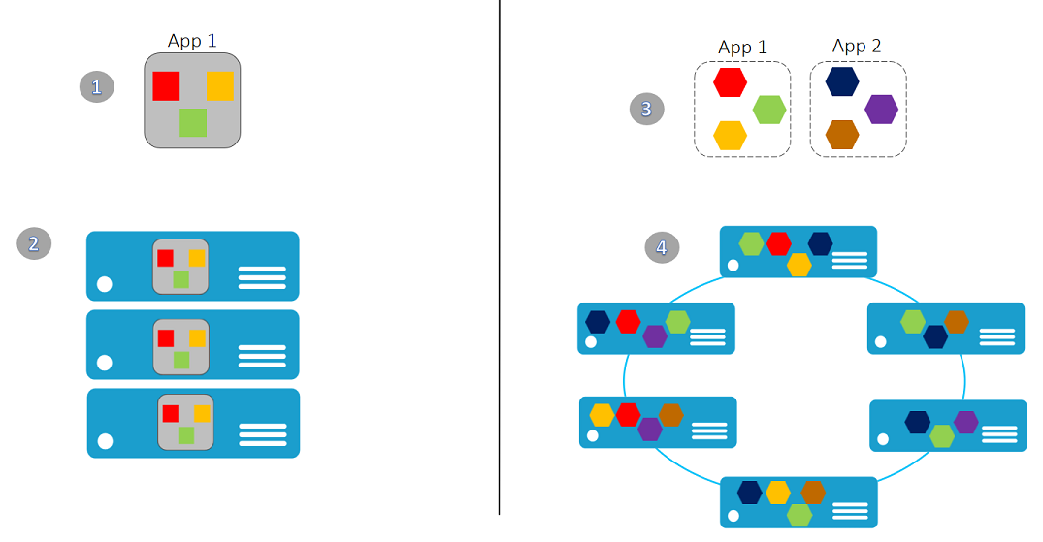
Evolution in Software Architecture
Monolith
Microservices
Serverless Cloud-Native

Slide 6
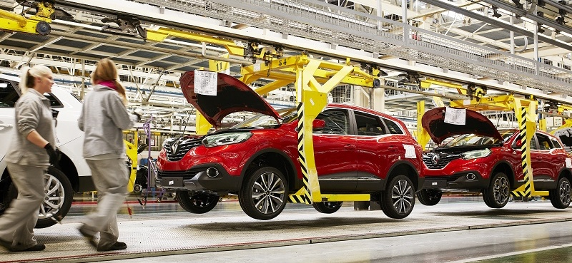
What is a Supply Chain?
Notes:
Image source: https://www.wardsauto.com/sites/wardsauto.com/files/styles/article_featured_retina/public/Renault%20Kadjar%20assembly%20line%20-%20Palencia%20Spain-5_8.jpg?

Slide 7






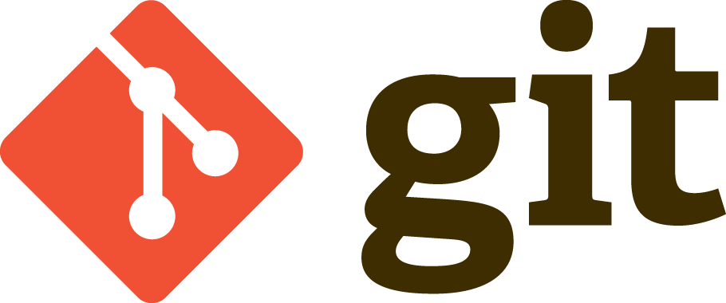


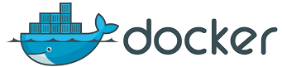
Software Supply Chain
Q&A
Developer
Source Repo
Build
Artifacts
Kubernetes

Slide 8
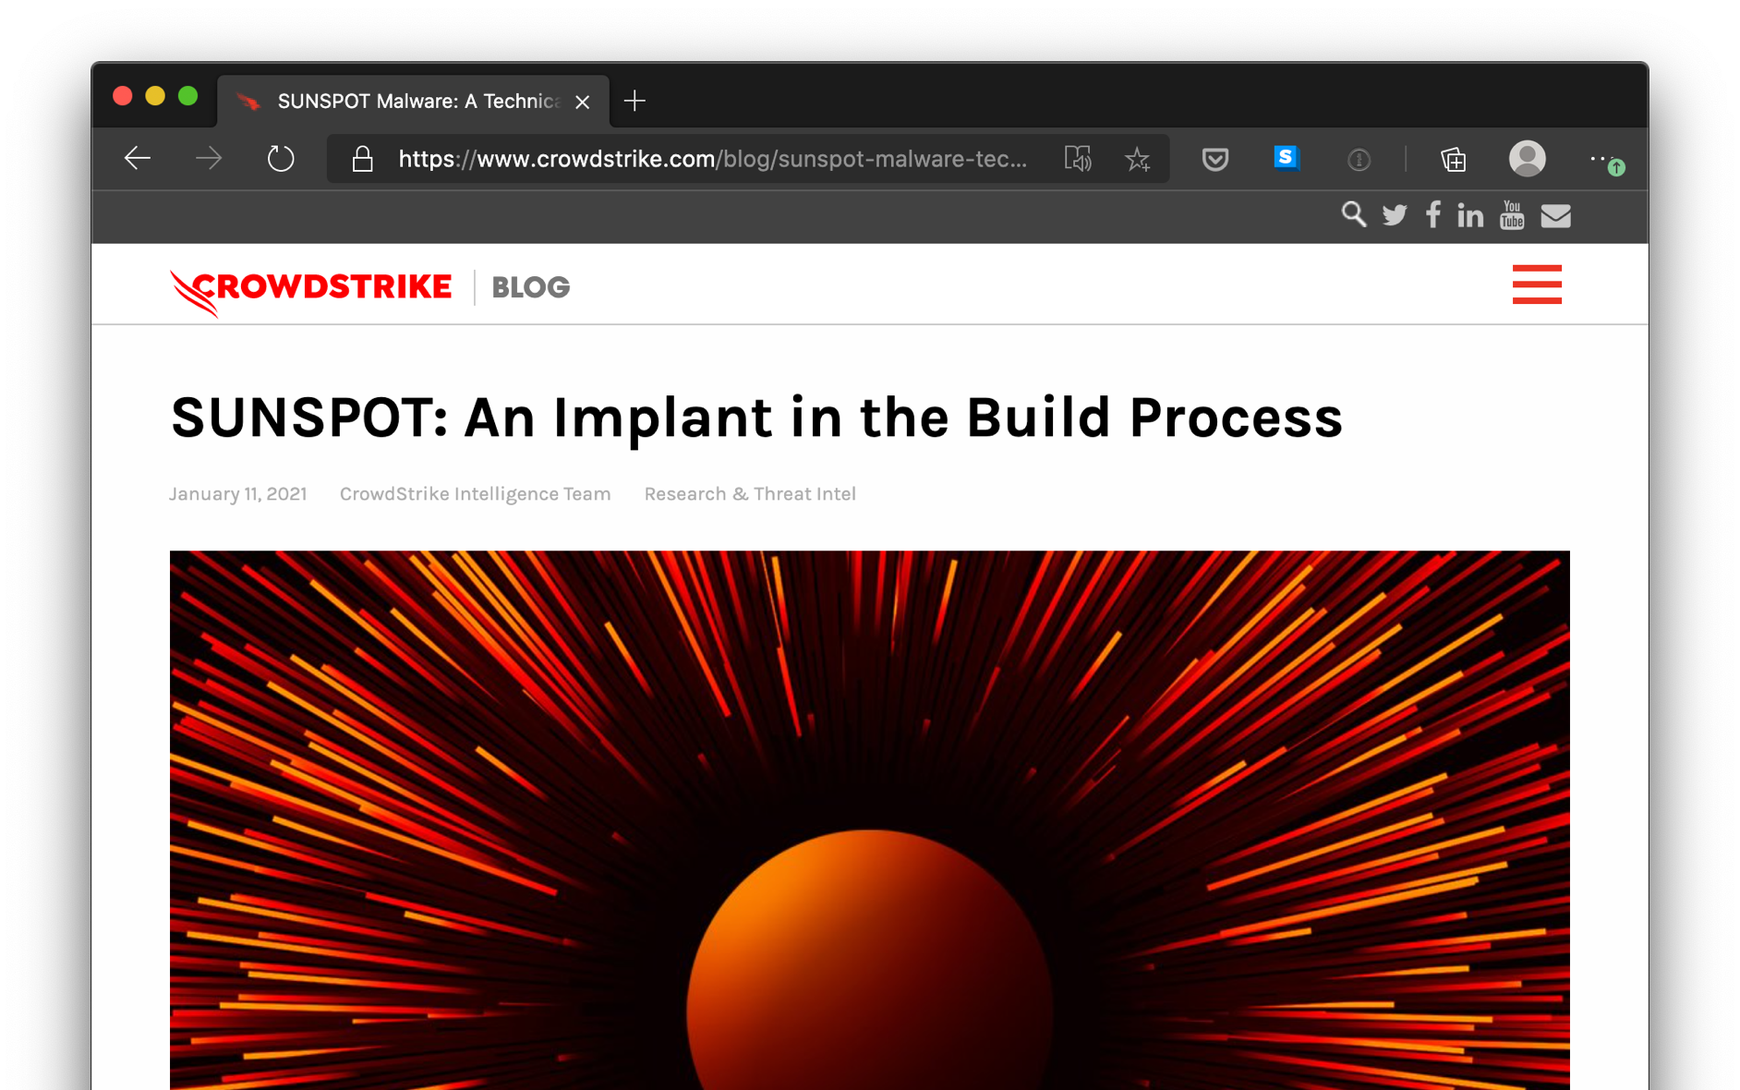
SolarWinds SunSpot
Notes:
https://www.crowdstrike.com/blog/sunspot-malware-technical-analysis/
https://www.microsoft.com/security/blog/2020/12/18/analyzing-solorigate-the-compromised-dll-file-that-started-a-sophisticated-cyberattack-and-how-microsoft-defender-helps-protect/

Slide 9
Software Supply Chain
Q&A
Developer
Source Repo
Build
Artifacts
Kubernetes

Slide 10
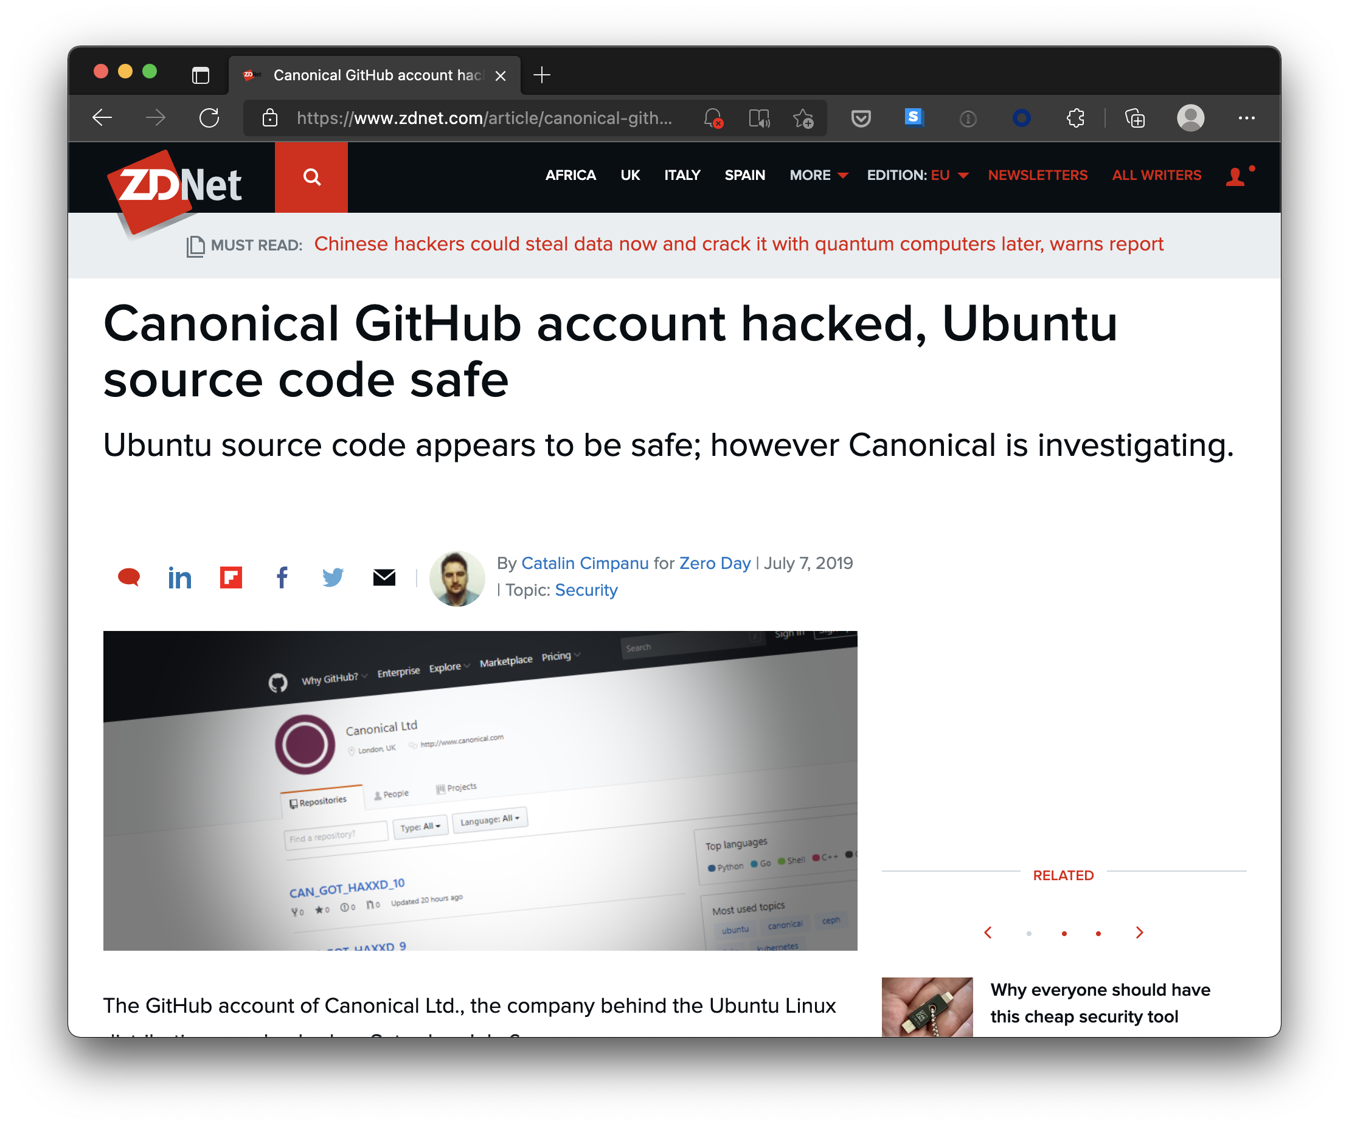
GitHub account
Notes:
https://www.zdnet.com/article/canonical-github-account-hacked-ubuntu-source-code-safe/

Slide 11
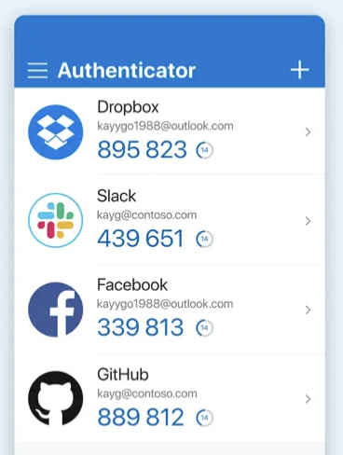
Use MFA on source-repository
Notes:
https://help.github.com/en/github/authenticating-to-github/configuring-two-factor-authentication

Slide 12
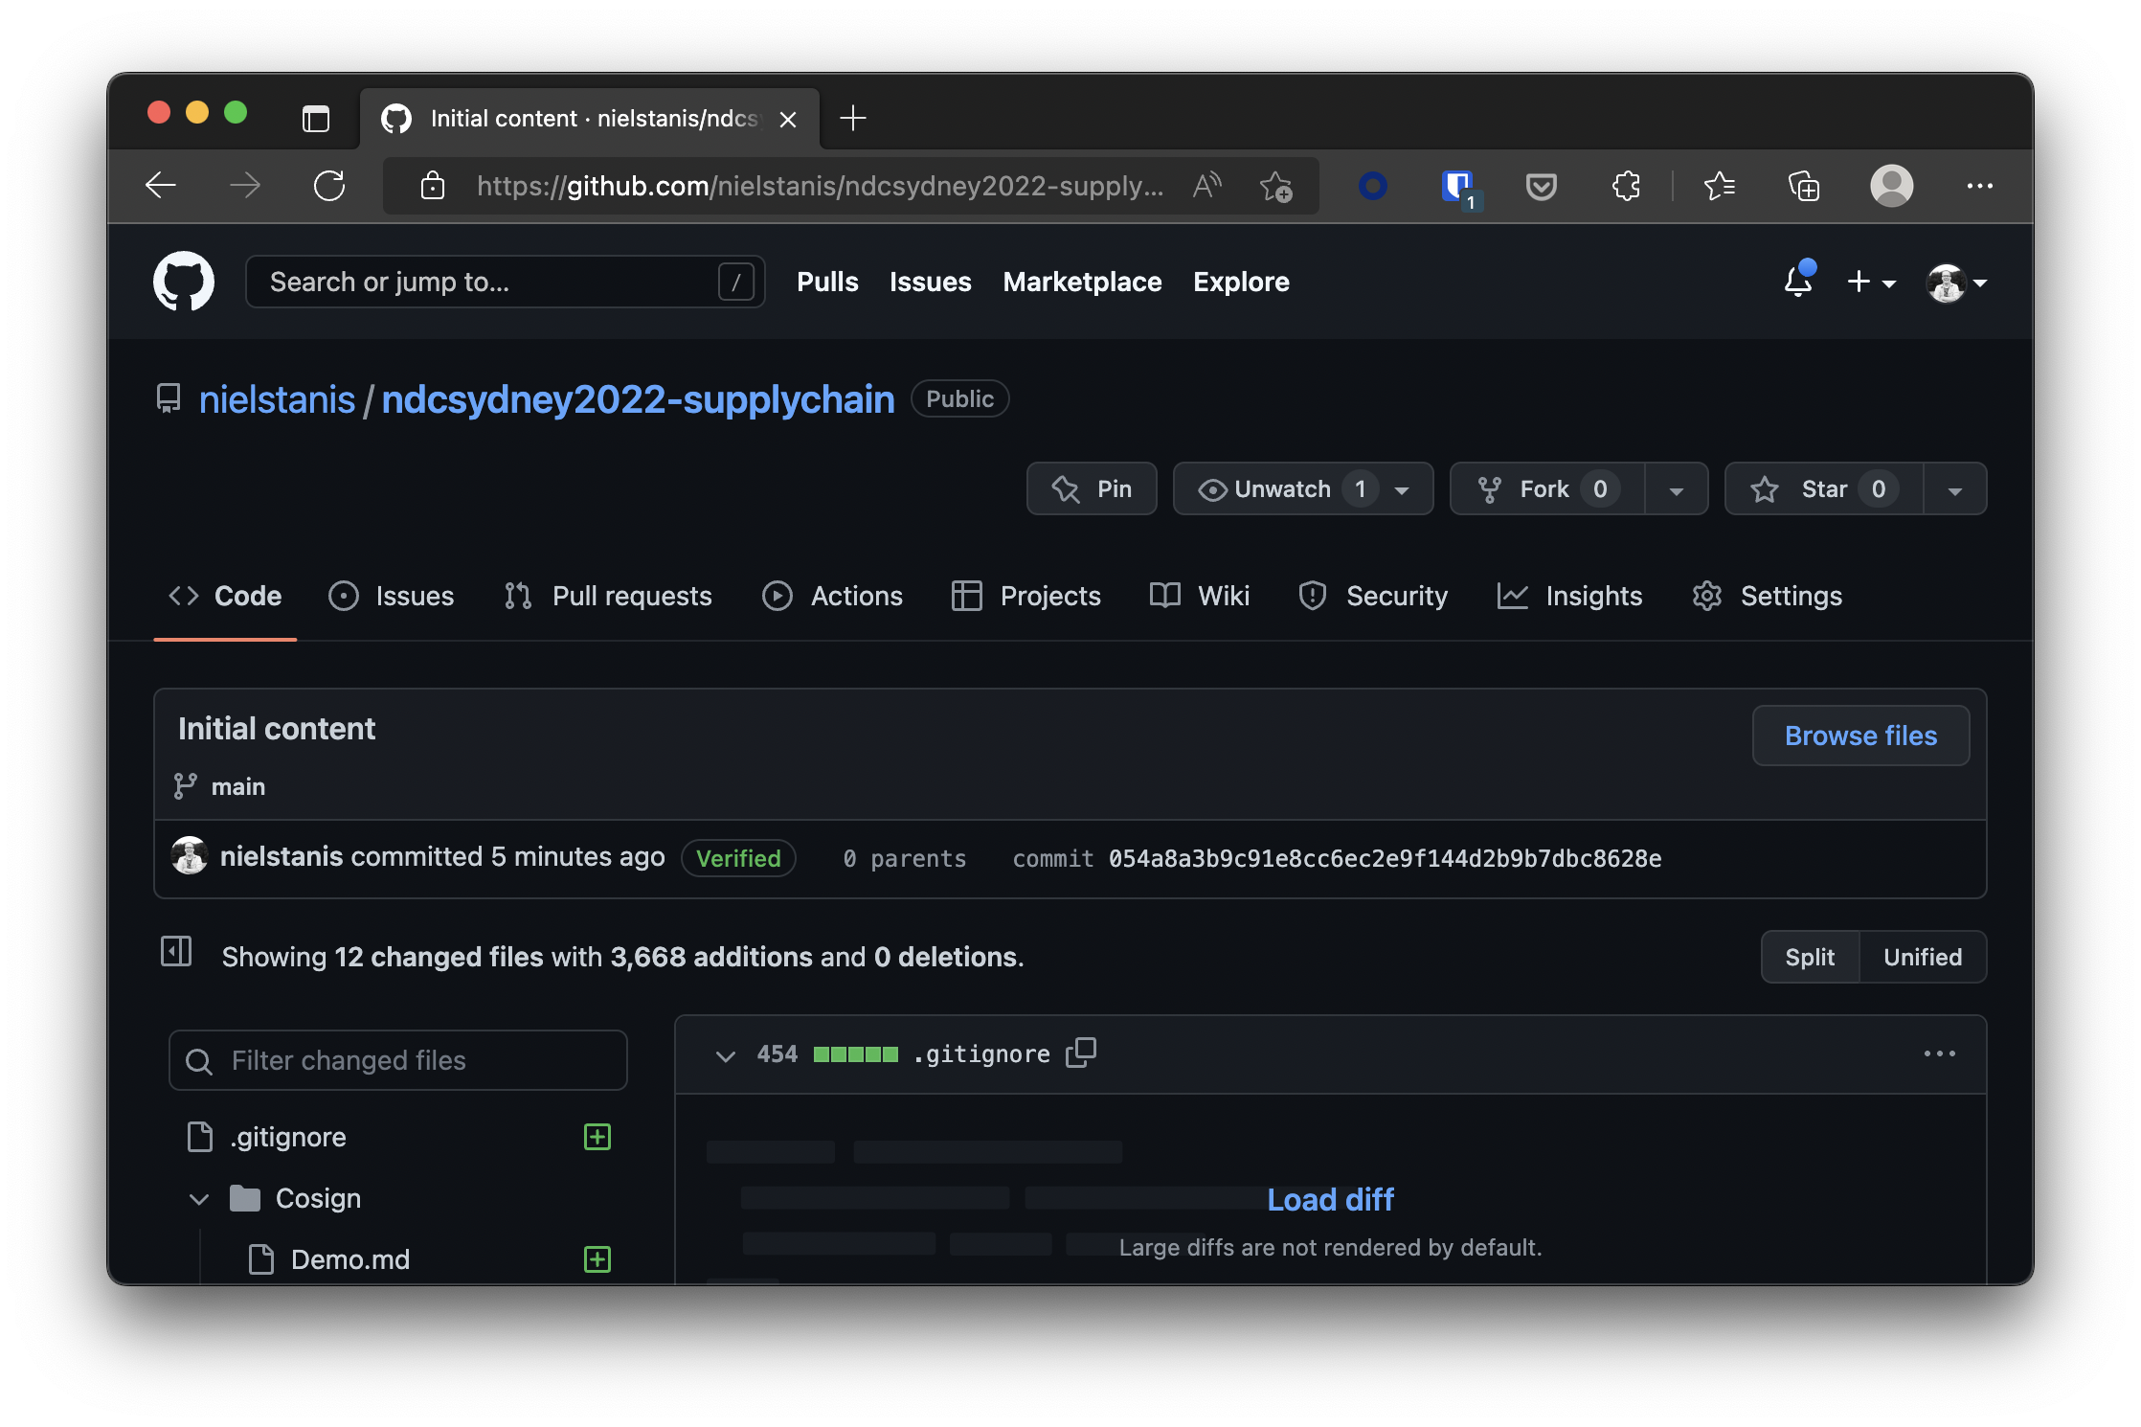
GIT Commit Signing
Notes:
https://www.hanselman.com/blog/HowToSetupSignedGitCommitsWithAYubiKeyNEOAndGPGAndKeybaseOnWindows.aspx

Slide 13
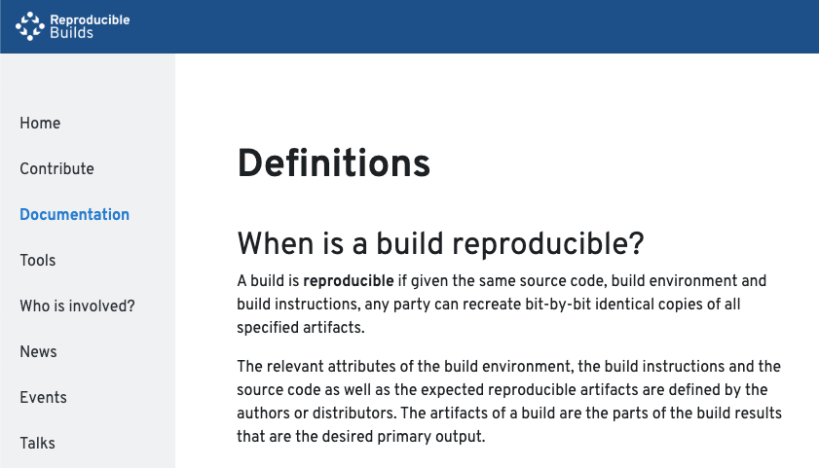
Reproducible/Deterministic Builds
Notes:
https://reproducible-builds.org/docs/definition/

Slide 14
Reproducible/Deterministic Builds
Roslyn v1.1 started supporting some kind of determinism on how items are emitted
Given same inputs, the compiled output will always be deterministic
Inputs can be found in Roslyn compiler docs ‘Deterministic Inputs’
Notes:
https://blog.paranoidcoding.com/2016/04/05/deterministic-builds-in-roslyn.html
https://github.com/dotnet/roslyn/blob/master/docs/compilers/Deterministic%20Inputs.md
https://github.com/clairernovotny/DeterministicBuilds

Slide 15
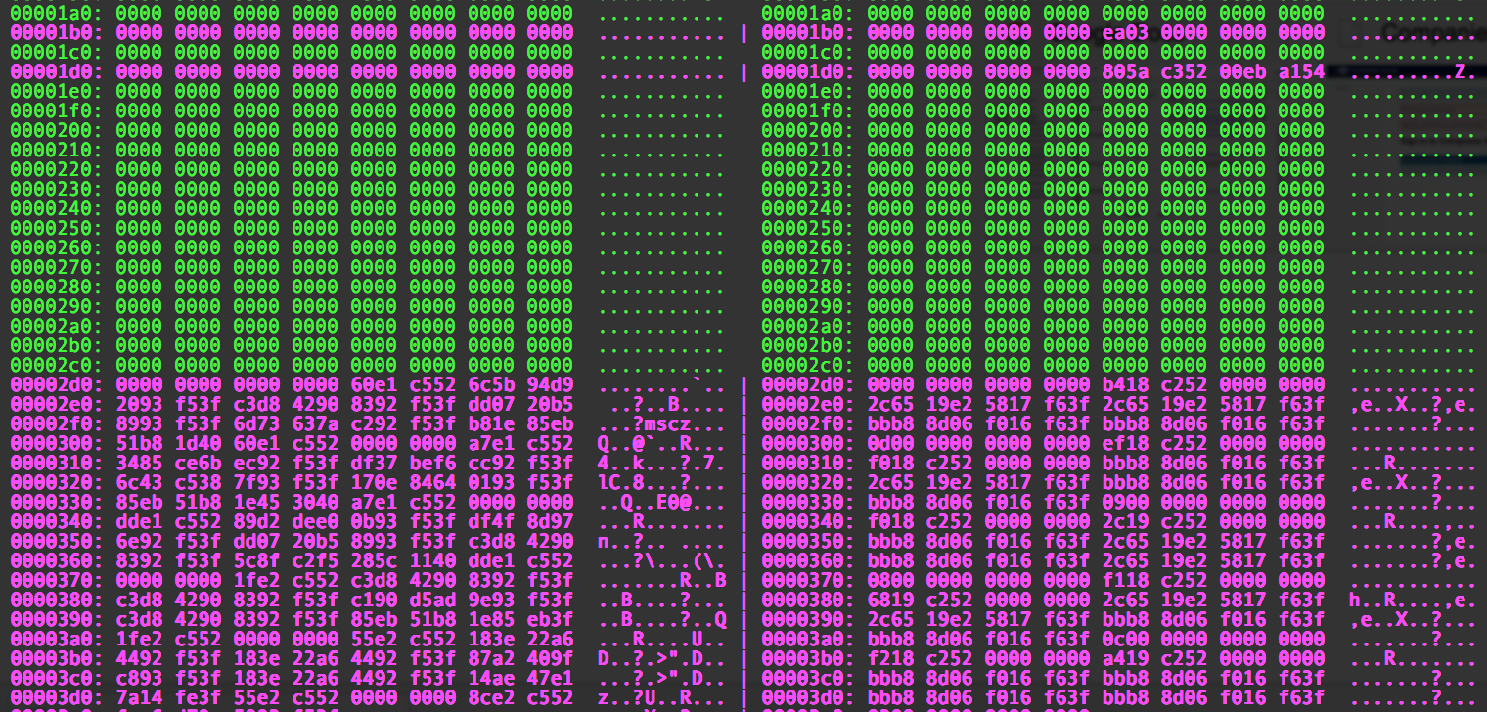
Reproducible Build .NET6
Notes:
https://www.tabsoverspaces.com/233662-changing-paths-in-pdb-files-for-source-files-and-pdb-file-path-in-dll-as-well
<DebugOutput> in CSPROJ demo

Slide 16
Reproducible/Deterministic Builds
DotNet.Reproducible NuGet Package
MSBuild ContinuousIntegrationBuild
SourceLink
Dotnet.Reproducible.Isolated NuGet Package
Hermetic builds
Notes:
https://blog.paranoidcoding.com/2016/04/05/deterministic-builds-in-roslyn.html
https://github.com/dotnet/roslyn/blob/master/docs/compilers/Deterministic%20Inputs.md
https://devblogs.microsoft.com/dotnet/producing-packages-with-source-link/
https://github.com/dotnet/reproducible-builds

Slide 17
Reproducible Build Validation
Design to validate NuGet packages & .NET binaries
Does linked source code match binaries?
Ability to rebuild reproducible based on given inputs
.NET CLI Validate tool dotnet validate
Notes:
https://github.com/dotnet/designs/blob/main/accepted/2020/reproducible-builds.md

Slide 18
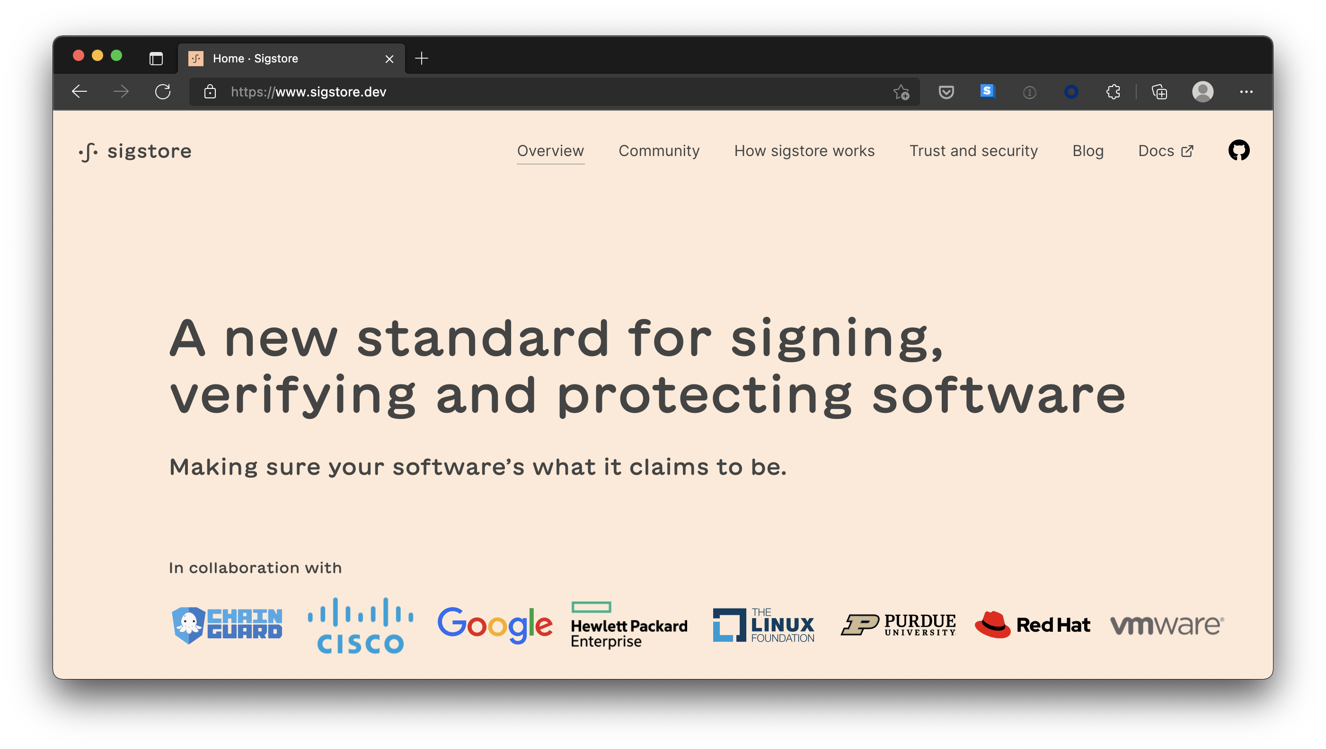
Signing artifacts
Notes:
https://sigstore.dev

Slide 19
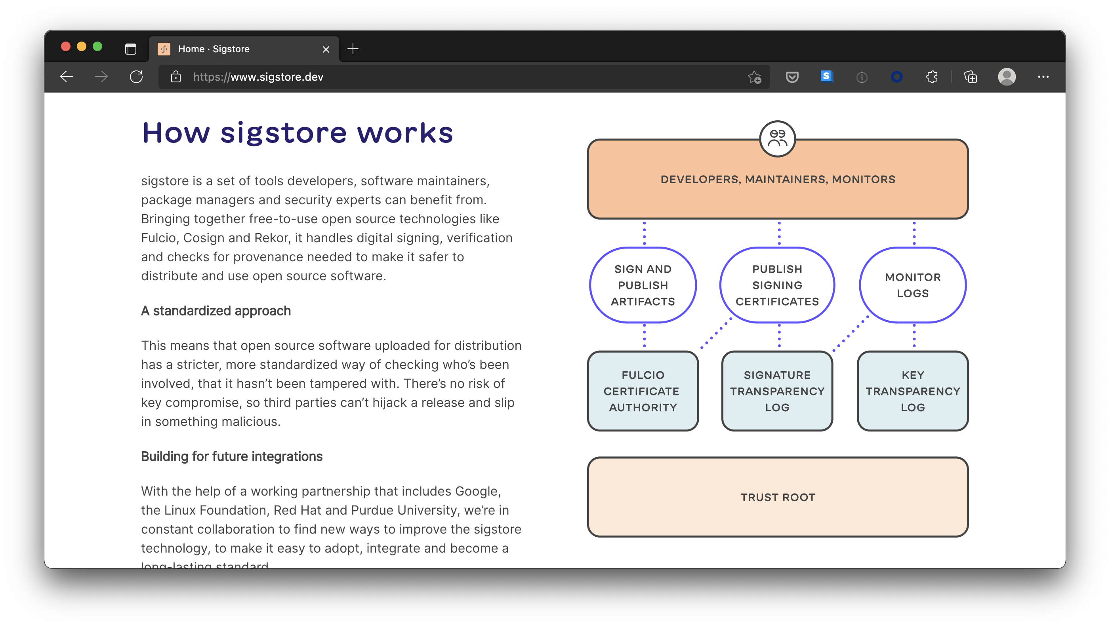
Signing artifacts
Notes:
https://sigstore.dev

Slide 20
Signing artifacts
Cosign can be used for signing files like binaries, packages and Docker images
It can do keyless signing based on OpenID Connect
GitHub Actions have released OpenID Connect support since end 2021
Notes:
https://sigstore.dev

Slide 21
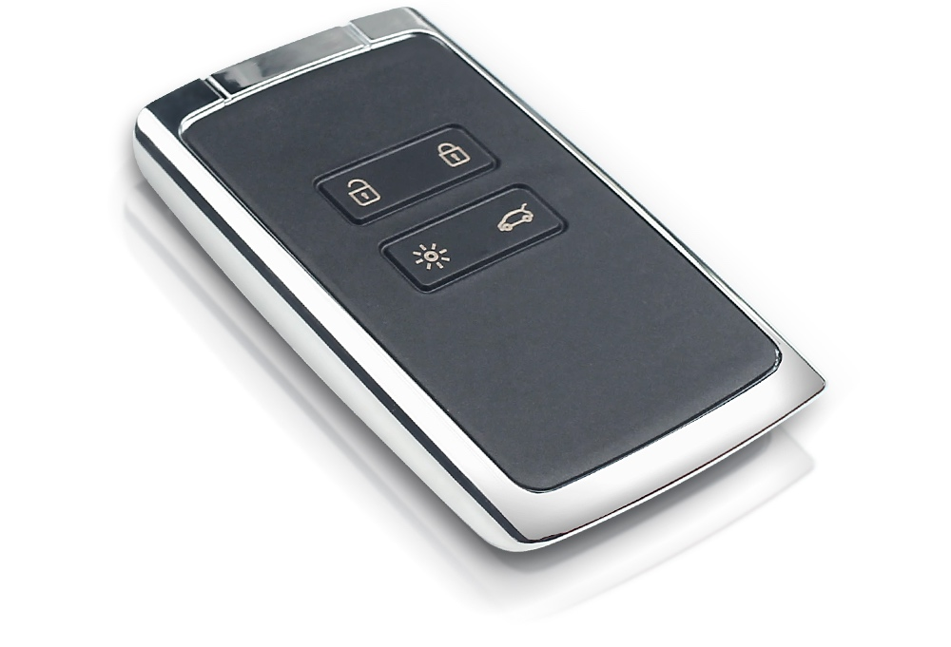
Cosign Keyless Signing
Notes:
https://sigstore.dev
https://blog.sigstore.dev/introducing-gitsign-9fd3f1b682aa

Slide 22
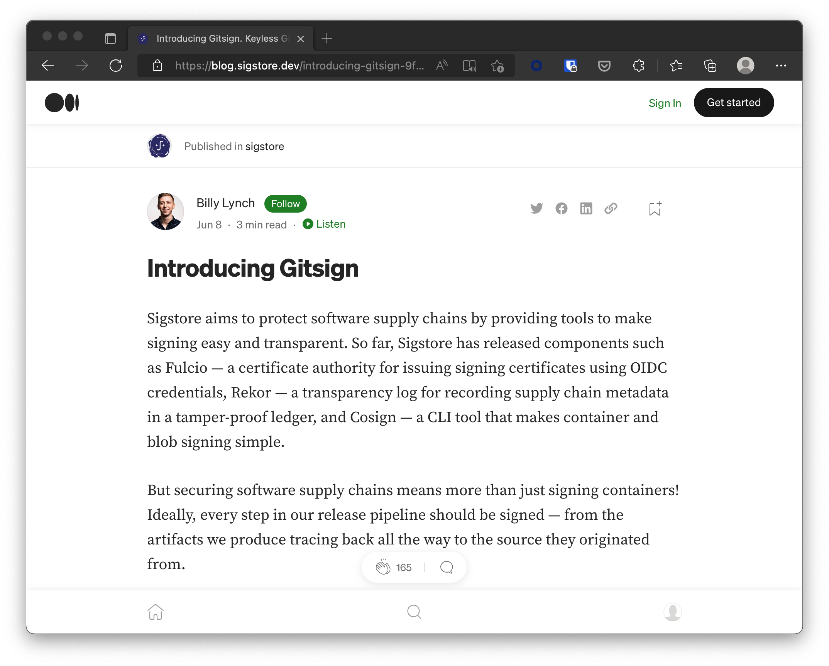
Git Commit Signing Sigstore GitSign
Notes:
https://sigstore.dev
https://blog.sigstore.dev/introducing-gitsign-9fd3f1b682aa

Slide 23
3rd Party Libraries
Q&A
Developer
Source Repo
Build
Artifacts
Kubernetes

Slide 24
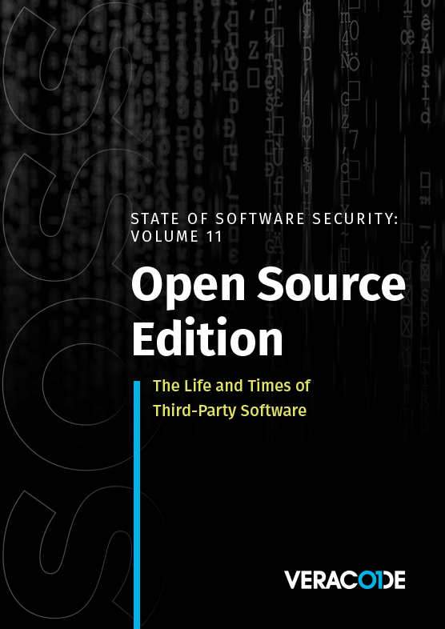
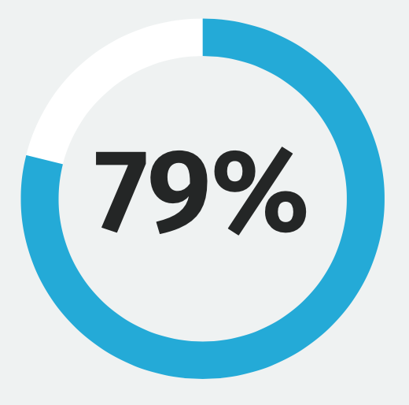
State Of Software Security v11 2021
”Despite this dynamic landscape, 79 percent of the time, developers never update third-party libraries after including them in a codebase.”
Notes:
https://info.veracode.com/fy22-state-of-software-security-v11-open-source-edition.html

Slide 25
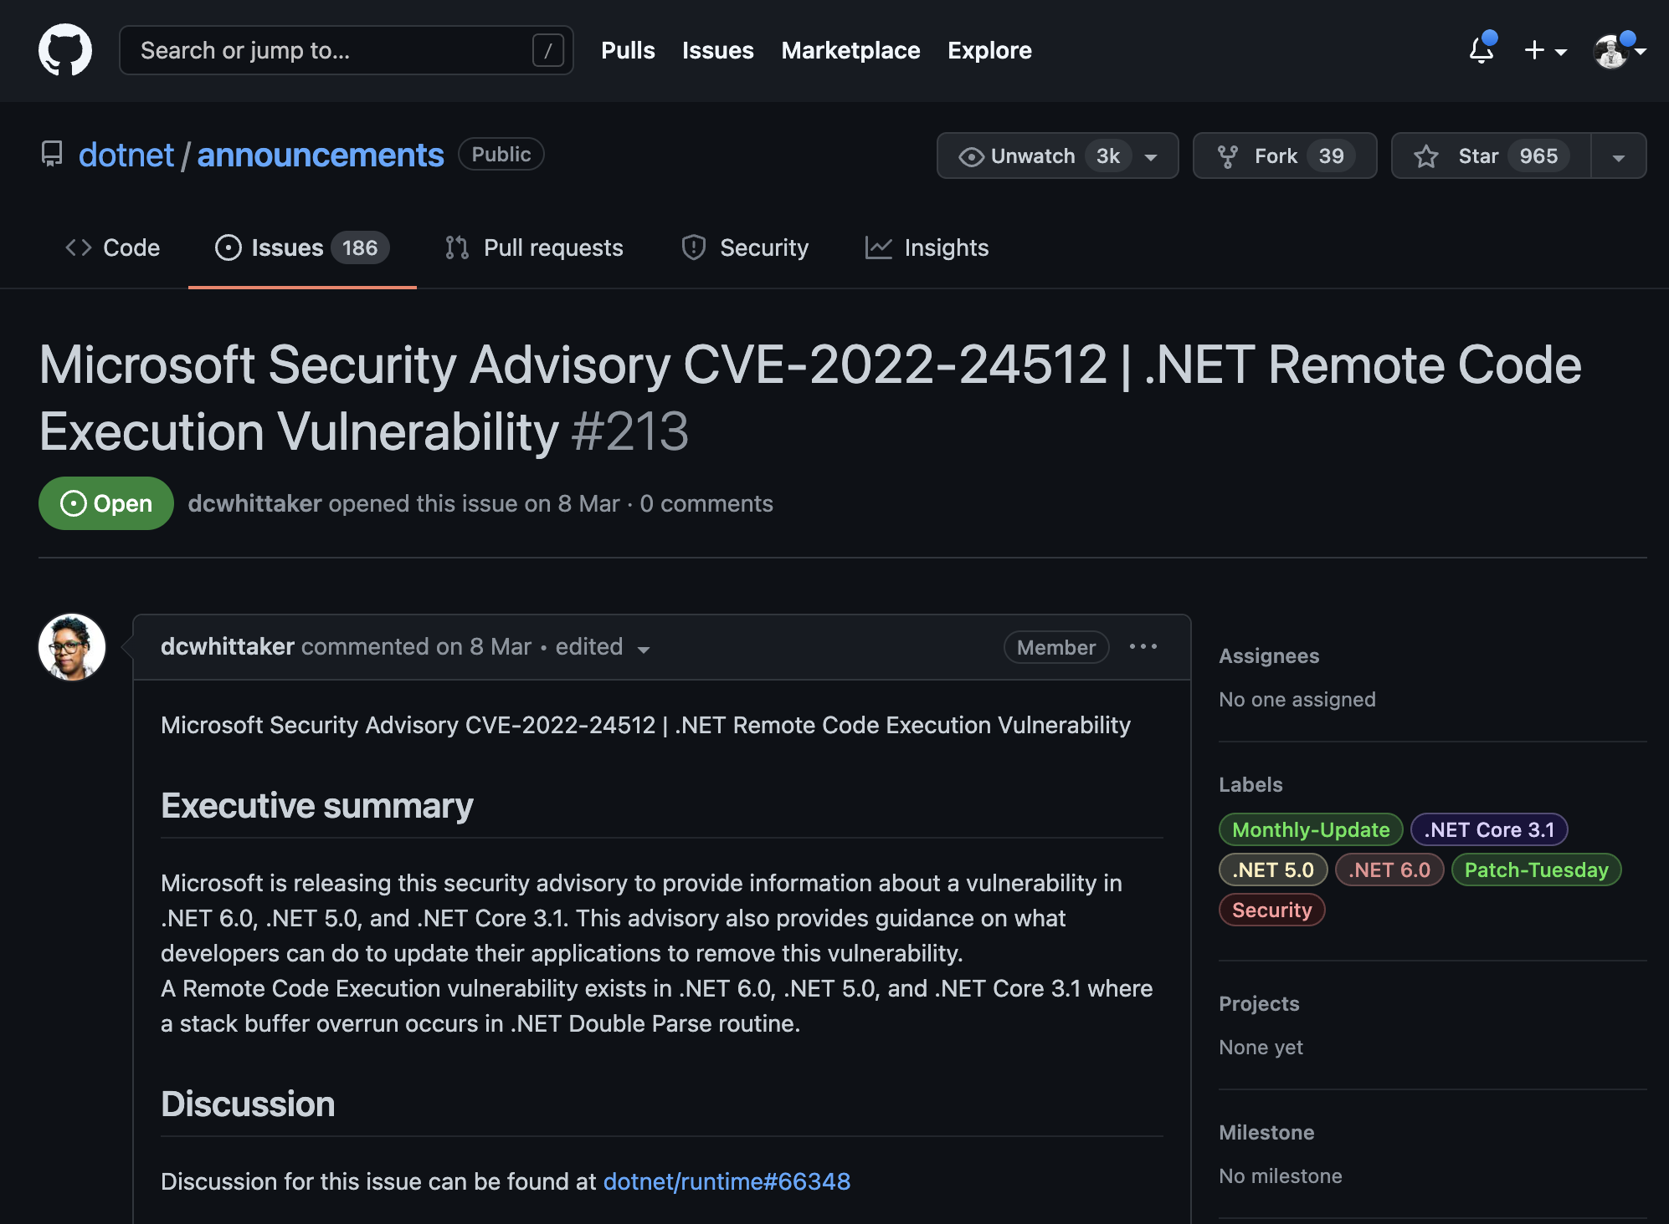
Vulnerabilities in libraries
Notes:
https://github.com/dotnet/announcements/issues/213

Slide 26
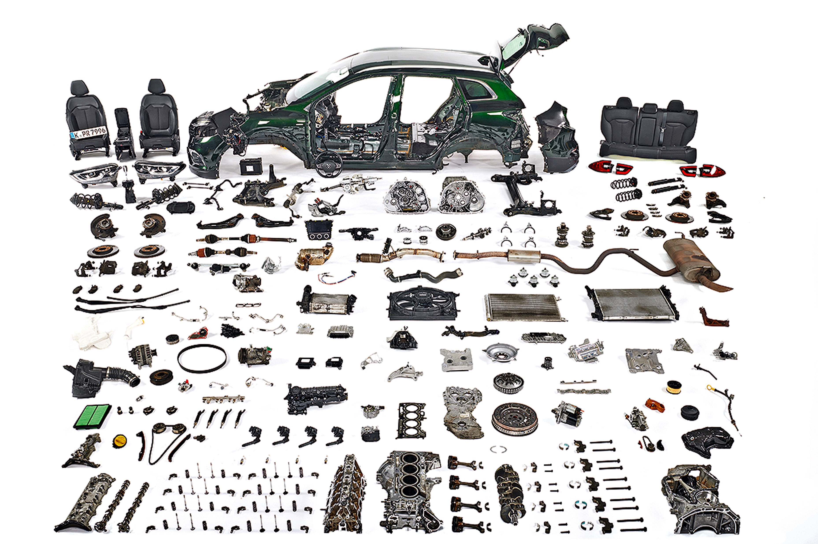
Automotive Industry

Slide 27

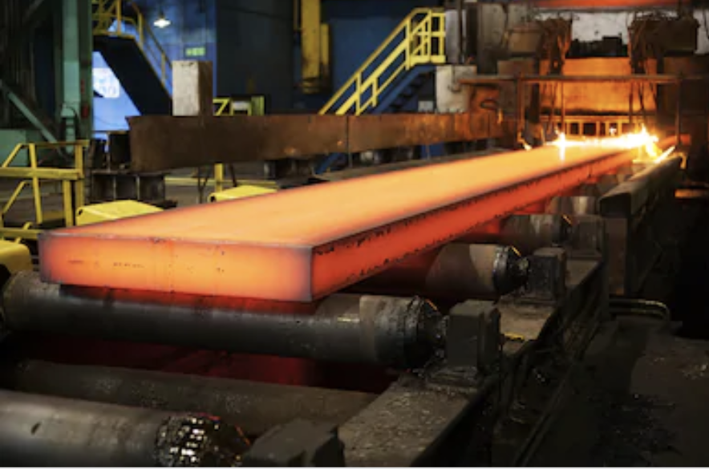

Car Supply Chain
Tata Steel Factory
Iron Ore from Sweden
ISO 6892-1 Tested/Certified
Batch #1234
Bosch Factory
Steel Batch #1234 Tata
ECE-R90 Tested/Certified
Serie #45678
Used by Ford, Volkswagen and Renault
Renault Manufacturing
Bosch Disk #45678
Bosal Exhaust #RE9876
Goodyear Tires #GY8877
Kadjar VIN 1234567890

Slide 28
Software Bill of Materials (SBOM)
Industry standard of describing the software
Producer Identity – Who Created it?
Product Identity – What’s the product?
Integrity – Is the project unaltered?
Licensing – How can the project be used?
Creation – How was the product created? Process meets requirements?
Materials - How was the product created? Materials/Source used?

Slide 29
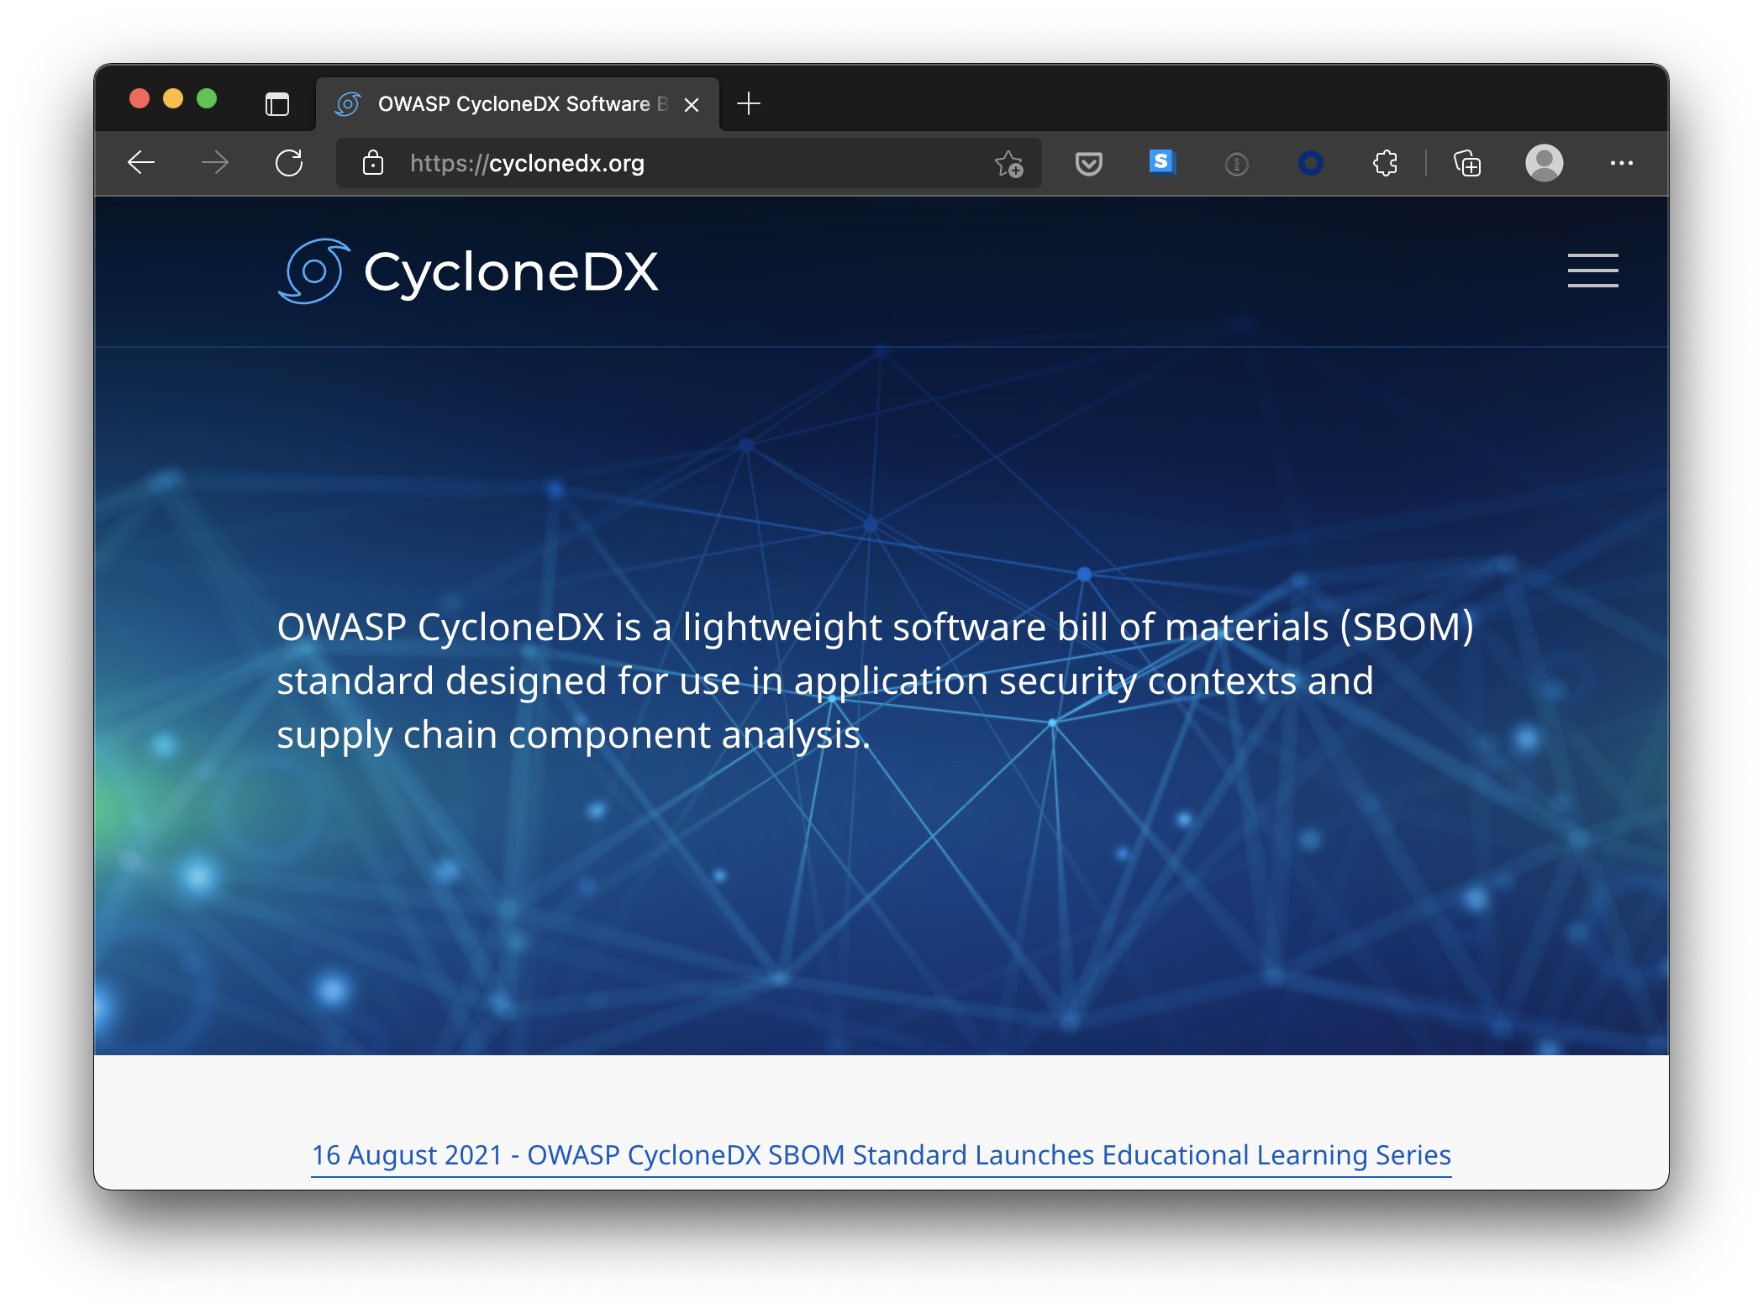
Software Bill of Materials (SBOM)
Notes:
https://cyclonedx.org

Slide 30
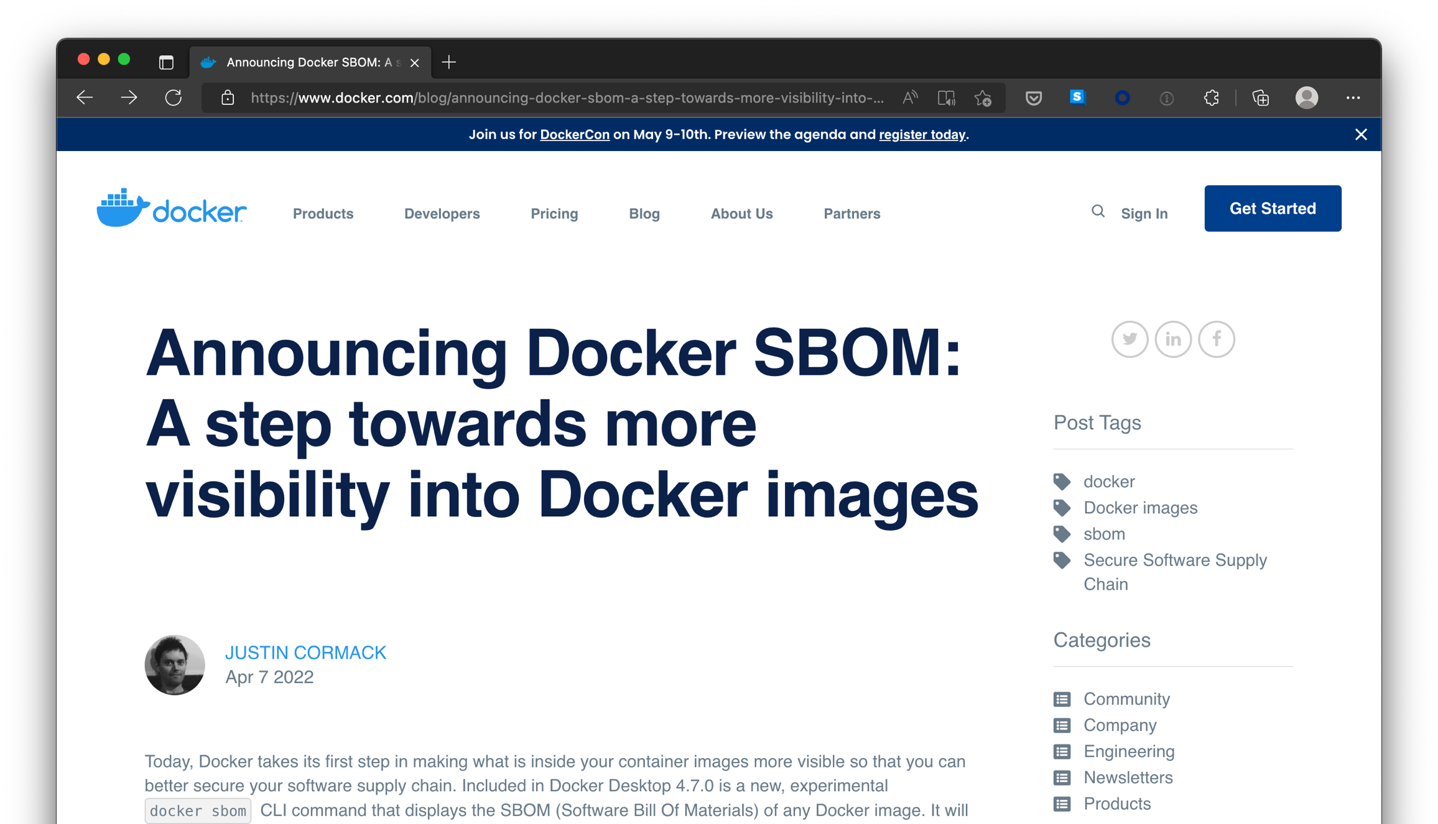
Docker SBOM
Notes:
https://www.docker.com/blog/announcing-docker-sbom-a-step-towards-more-visibility-into-docker-images/

Slide 31
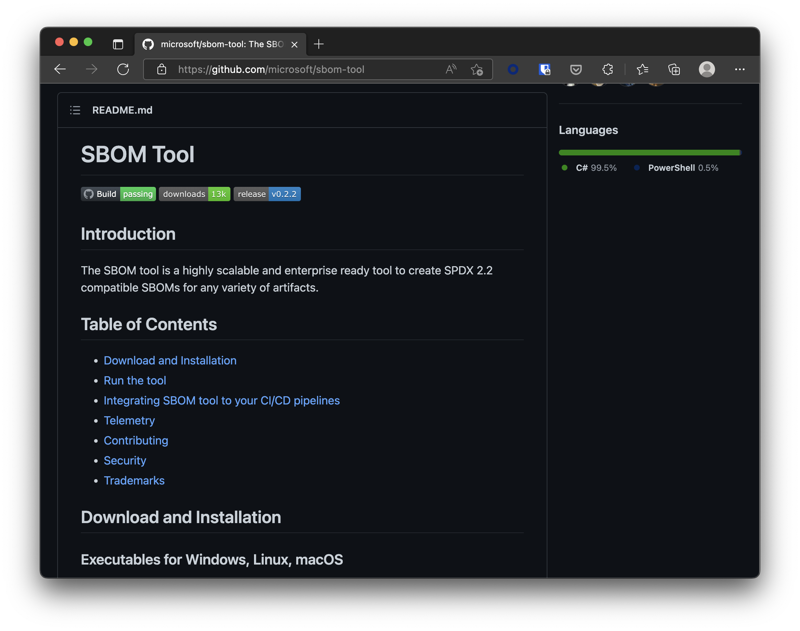
Microsoft SBOM Tool
Notes:
https://github.com/microsoft/sbom-tool

Slide 32
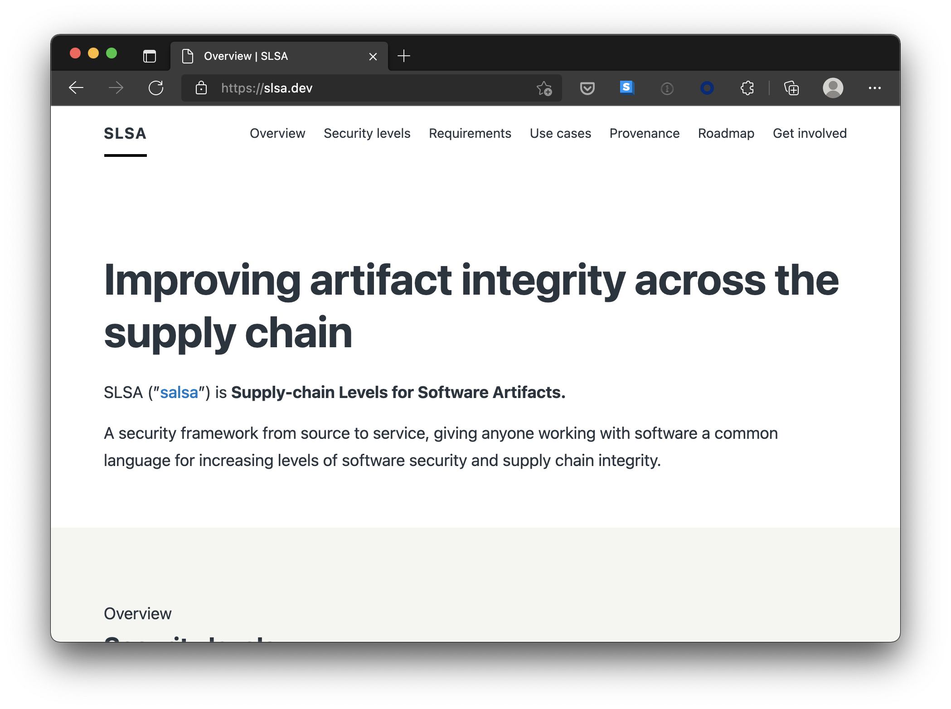
Google SLSA
Notes:
https://slsa.dev

Slide 33
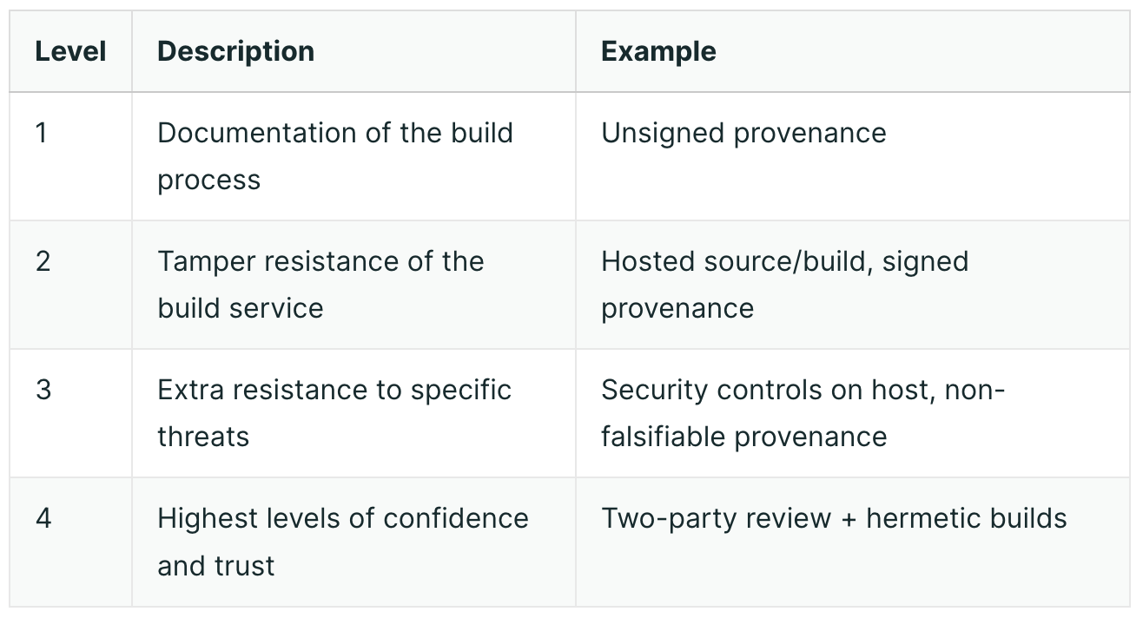
Google SLSA Levels
Notes:
https://slsa.dev

Slide 34
Google SLSA Levels
The build process must be fully scripted/automated and generate provenance.
Requires using version control and a hosted build service that generates authenticated provenance.
The source and build platforms meet specific standards to guarantee the auditability of the source and the integrity of the provenance respectively.
Requires two-person review of all changes and a hermetic, reproducible build process.
Notes:
https://slsa.dev

Slide 35
SLSA GitHub Action
Released April 2022
SLSA level 2 provenance generator in GitHub Action
SLSA level 3+ provenance generator for Go binaries
GitHub Hosted Runner
Uses SigStore to do keyless signing with GitHub OIDC
Verifier included
Notes:
https://security.googleblog.com/2022/04/improving-software-supply-chain.html

Slide 36
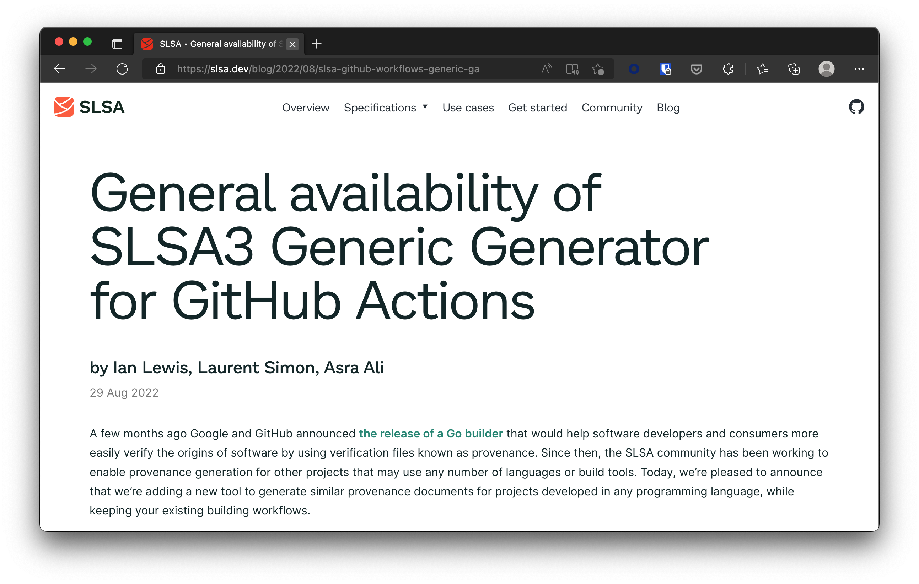
SLSA3 Generator GitHub Actions
Notes:
https://slsa.dev/blog/2022/08/slsa-github-workflows-generic-ga

Slide 37
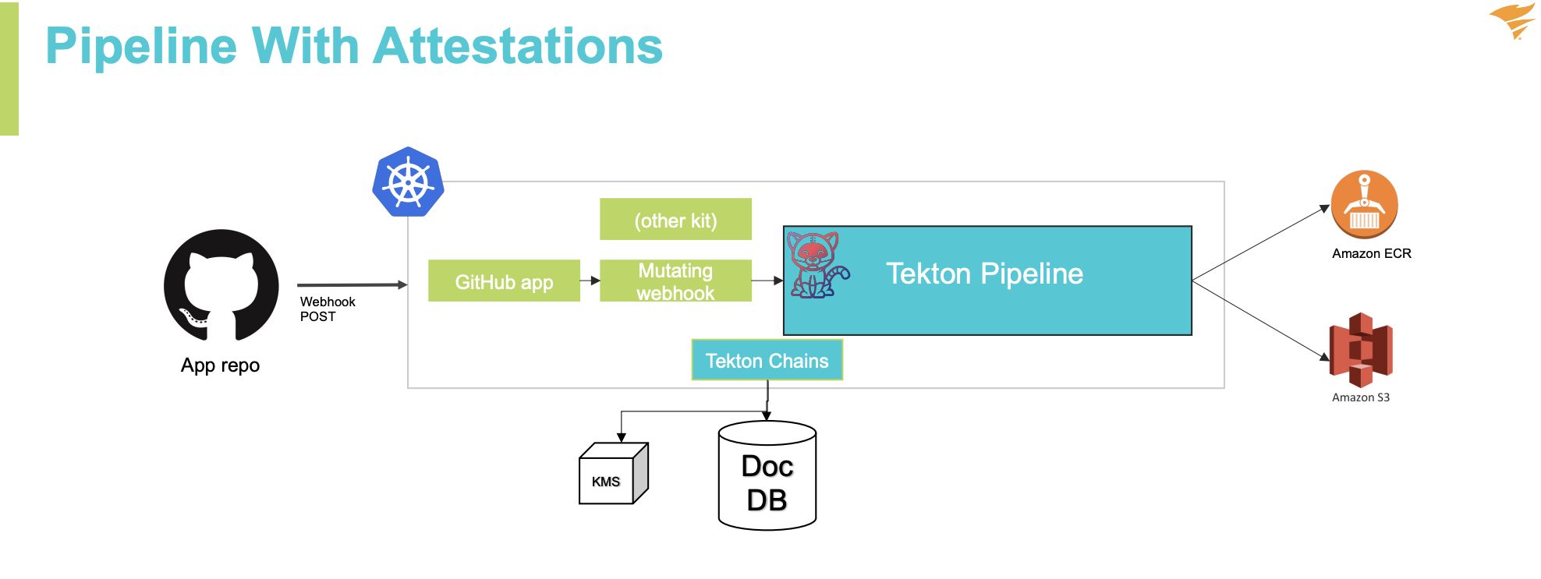
SolarWinds Project Trebuchet
Notes:
https://static.sched.com/hosted_files/supplychainsecurityconna21/df/SupplyChainCon-TrevorRosen-Keynote.pdf
https://www.youtube.com/watch?v=1-tMRxqMwTQ

Slide 38
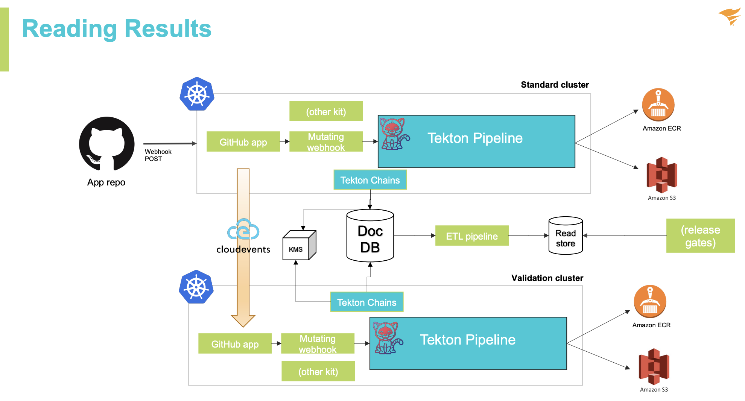
SolarWinds Project Trebuchet
Notes:
https://static.sched.com/hosted_files/supplychainsecurityconna21/df/SupplyChainCon-TrevorRosen-Keynote.pdf
https://www.youtube.com/watch?v=1-tMRxqMwTQ

Slide 39
Thanks! Questions?
https://github.com/nielstanis/ndclondon2023-supplychainws ntanis at veracode.com
@nielstanis@infosec.exchange on Mastodon

